Slide 1
Getting Started with Test Automation
Part 2: Page Objects

Slide 2
Lunch n’ Learn Materials
All slides, example code, and any other material from these lunch sessions is available.
All examples can be viewed/copied from GoogleDrive
https://drive.google.com/open?id=0BwPovPyaC-TnT3FsbnYzZjk3NUU
Code examples are in the Examples folder. Copy the entire folder Part_3_Se_Page_Objects to the location below( on Windows). If you have installed any packages, you will already have the node_modules\ folder. You may need to create the projects\ directory inside of the already existing node_modules\ if you have not already done so.
C:\Users\your.user.name\AppData\Roaming\npm\node_modules\projects\

Slide 3
First Things First, What is an Object?
JavaScript(and most programming languages) have different Data Types
Primitive Types (in JavaScript)
Boolean (has only 2 possible values: true or false)
Number - can be an integer (whole number) or floating point number (with decimals)
String - any number of characters
Null - nothing; no value
Undefined
Reference Types / Objects
Basically, an object in JavaScript is a collection of properties in the form of key-value pairs
The syntax is as follows { propertyName: someValue}. Use a comma to separate additional properties
Sometimes it is only data, such as a bunch of primitive types
{ name: ‘Eric’, age: 40, height: 73, weight: ‘:-)’ iq: 62 }

Slide 4
What is an Object? (Continued)
Reference Types / Objects (Continued)
Sometimes objects also have functions that perform some action. In object terminology, we call those methods.
If you see the word function in an object, that always indicates a method.
There are no classes in JavaScript. If you are familiar with C++, Java or C#, this is going to look a little different. However, we can achieve pretty similar results in our tests.
Wait, what is a class? Think of it as the blueprint that describes all of the properties and methods in our object.
A class is used to create an instance of an object. This is called instantiation.

Slide 5
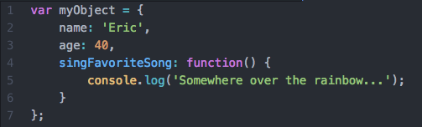
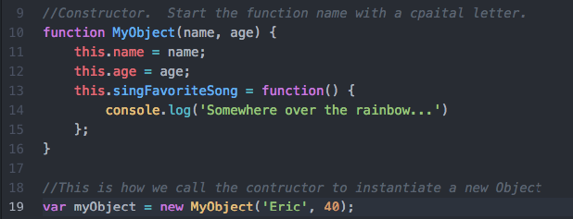
What is an Object? (Continued)
So how do we create objects in JavaScript? There are a couple of ways.
Object literals - these work the same as declaring any other variable.
Constructors - these are just functions to create new instances of objects.

Slide 6
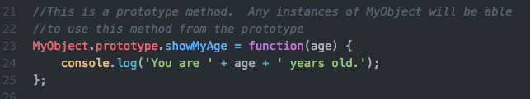
What is an Object? (Continued)
So how do we create multiple like objects without classes?
Prototypes - every object has a prototype that has methods and properties. This is kind of like a blueprint
Methods tend to be the same across like object instances, so we can access the prototype methods in our objects
This is important for inheritance in JavaScript. That’s a topic for a future lesson.

